Slide 1





HTML Forms
Class: 8
Lab : 24

Slide 2

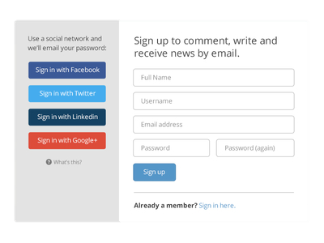


Form
A webform, web form or HTML form on a web page allows a user to enter data that is sent to a server for processing

Slide 3
Form Element
The HTML <form> element defines a form that is used to collect user input:
<form> . form elements . </form>

Slide 4
Input Element
The HTML <form> element defines a form that is used to collect user input:
<form> . form elements . </form>

Slide 5
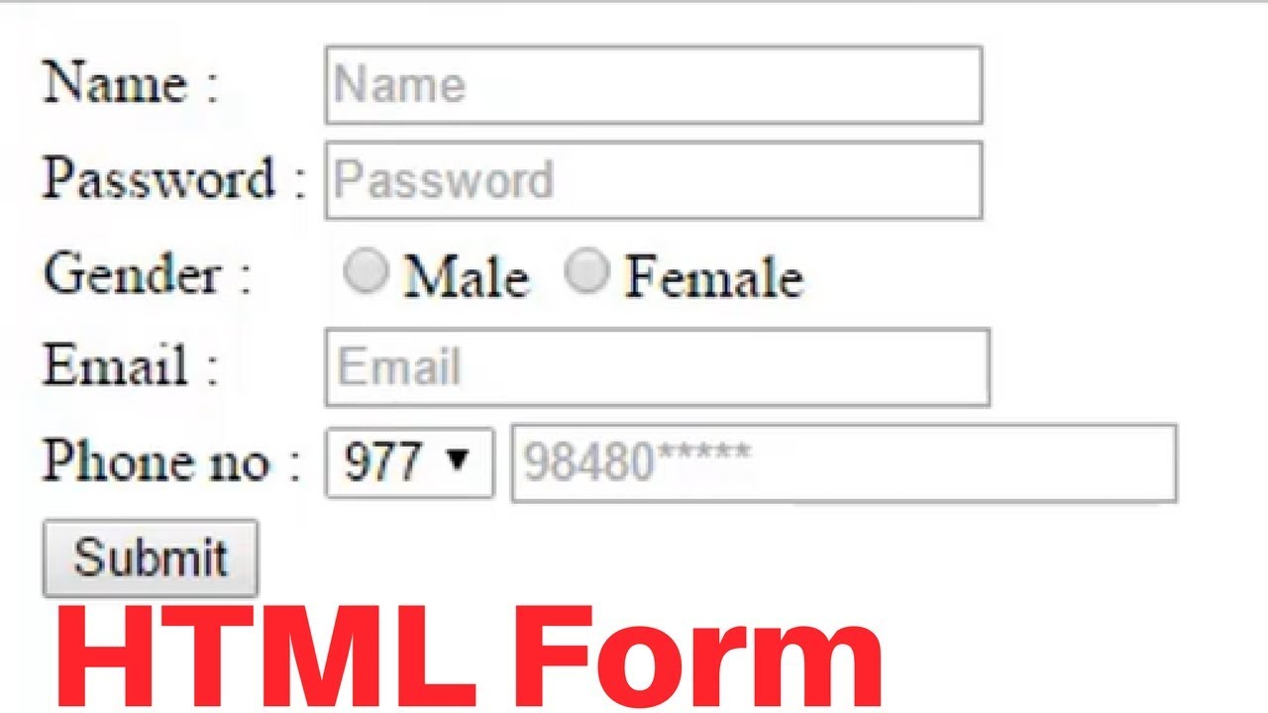

Input type
Text
Search
Checkbox
File
Image
Password
Radio
Reset
submit

Slide 6
Input type
Text
Search
Checkbox
File
Image
Password
Radio
Reset
submit

Slide 7
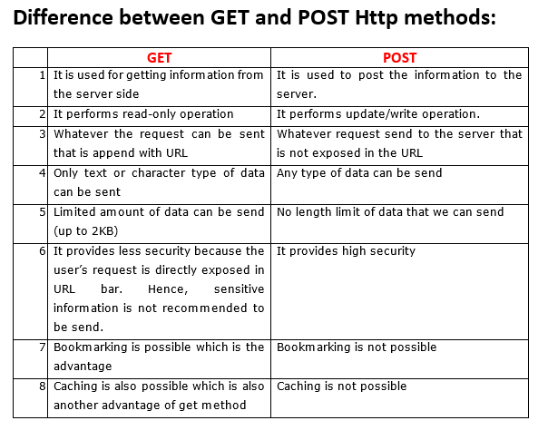
GET vs POST

Slide 8



